Slide 1

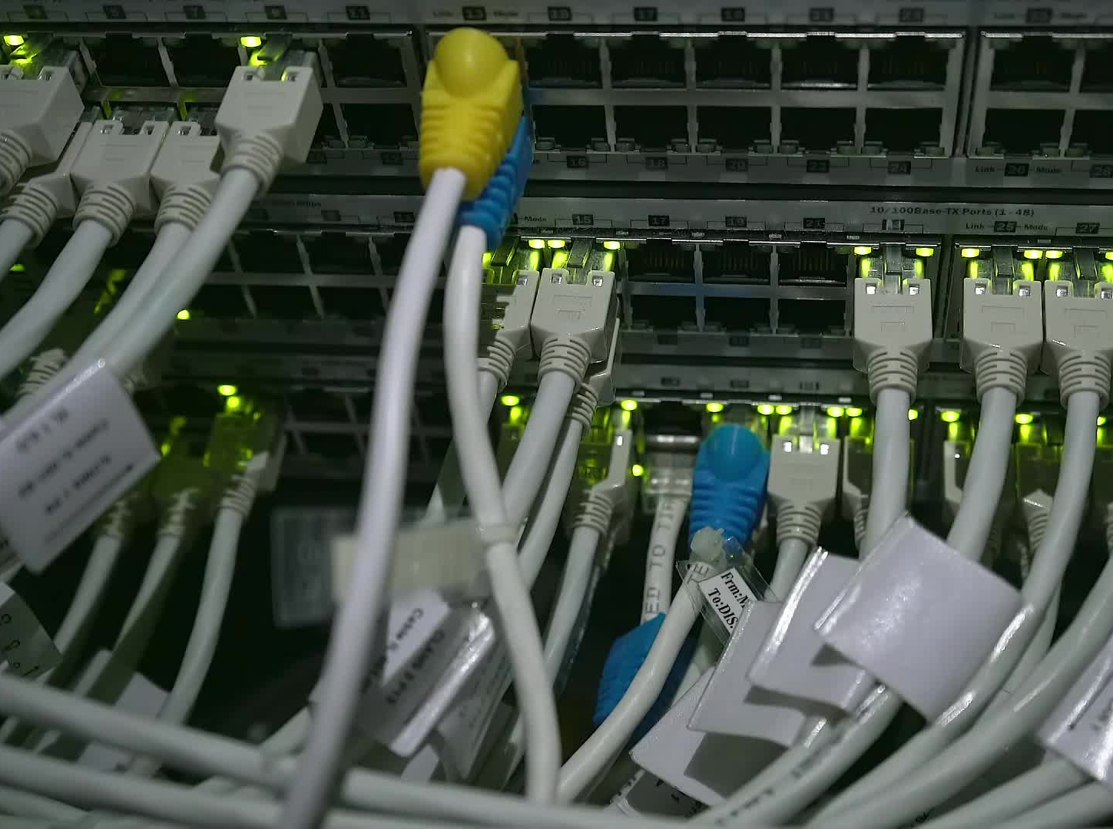


CS621 Parallel and Distributed Computing
Dr. Muhammad Anwaar Saeed
Dr. Said Nabi
Ms. Hina Ishaq

Slide 2
CS621 Parallel and Distributed Computing
Introduction to Load Balancing

Slide 3
Objectives
Introduction of Load Balancing.
Issues in Load Balancing.

Slide 4
Introduction to Load Balancing
“The goal of partitioning is to distribute the computation load to each processing element such that all processing elements become neither overloaded nor idle and all processors can finish their computation at about the same time.”

Slide 5
Introduction to Load Balancing Cont…
Distributed computing system provides high performance environment that are able to provide high processing power.
Deals with distribution of processes among processors connected by a network.
For homogeneous parallel systems, the computation load is distributed as evenly as possible in a parallel computer.
For heterogeneous parallel system, the computation load is distributed according to the computing power of each processor.

Slide 6
Issues in Load Balancing
A load balancing strategy needs to resolve following issues:
What load information (measurements) can be used.
When to invoke balancing, i.e., conditions to balance.
Which nodes make the load balancing decision.
How should old data be handled.
How load migrations are to be managed.

Slide 7
CS621 Parallel and Distributed Computing
Mapping Techniques for Load Balancing

Slide 8
Objectives
Understanding of Mapping Techniques for Load Balancing.
The need of Mapping Techniques for Load Balancing.

Slide 9
Mapping Techniques for Load Balancing
The computation domain is partitioned into several subdomains and then mapped onto processors of a parallel system with the objective that all tasks complete in the shortest amount of elapsed time.
In order to achieve a small execution time, the overheads of executing the tasks in parallel must be minimized.
In general, the number of subdomains equals to the number of processors in a parallel system.

Slide 10


Quality of Load Balancing Algorithm
The quality of load balancing algorithms can be measured by two factor:
Number of steps: Needed to get the balanced state.
Extent of loads: Moves over the link to which nodes are connected.

Slide 11
Mapping Techniques for Load Balancing
There are two key sources of overhead. The time spent in inter-process interaction is one source of overhead. Another important source of overhead is the time that some processes may spend being idle.
A good mapping of tasks onto processes must strive to achieve the twin objectives:
Reducing the amount of time processes spend in interacting with each other
Reducing the total amount of time some processes are idle while the others are engaged in performing some tasks.

Slide 12
Mapping Techniques for Load Balancing
Mapping techniques used in parallel algorithms can be broadly classified into two categories:
Static Mapping.
Dynamic Mapping.
The parallel programming paradigm and the characteristics of tasks and the interactions among them determine whether a static or a dynamic mapping is more suitable.

Slide 13
CS621 Parallel and Distributed Computing
Static Mapping for Load Balancing

Slide 14
Objectives
Understanding of Static Mapping for Load Balancing.
Advantages
Disadvantages

Slide 15
Static Mapping for Load Balancing
“Static mapping techniques distribute the tasks among processes prior to the execution of the algorithm.”

Slide 16
Static Mapping for Load Balancing Cont…
Processes are assigned to the processors at compile time.
Once the process are assigned, no change or reassignment is possible at run time.
Need a good estimate of task sizes.
Number of jobs on each node is fix.
Scheduling decisions are made probabilistically.

Slide 17
Advantages of Static Mapping
Algorithms that make use of static mapping are in general easier to design and program.
Less network traffic due to load balancing related messages.
Since the mapping is fixed, there is no need for communication between processing nodes to determine task allocation.
This reduces communication overhead and can improve performance.

Slide 18
Disadvantages of Static Mapping
It is very difficult to compute a-priori execution time.
The process allocation cannot be changed during execution.
Lack of Fault Tolerance: Static mapping does not account for node failures, which can result in system downtime if a node fails.

Slide 19
CS621 Parallel and Distributed Computing
Schemes for Static Mapping

Slide 20
Objectives
Mappings Based on Data Partitioning.
Mappings Based on Task Partitioning.
Hierarchical Mappings.

Slide 21
Schemes for Static Mapping
Static mapping is often used in conjunction with a decomposition based on data partitioning.
Static mapping is also used for mapping certain problems that are expressed naturally by a static task-dependency graph. Mapping schemes based on data partitioning and task partitioning are:
Mappings Based on Data Partitioning
Hierarchical Partitioning
Mappings Based on Task Partitioning

Slide 22
Mappings Based on Data Partitioning
  Mappings based on data partitioning’s two of the most common ways of representing data in algorithms, namely, arrays and graphs.
  Block Distribution Schemes
    Block Array Distributions
    Cyclic and Block-Cyclic Distributions
    Randomized Block Distributions

Slide 23
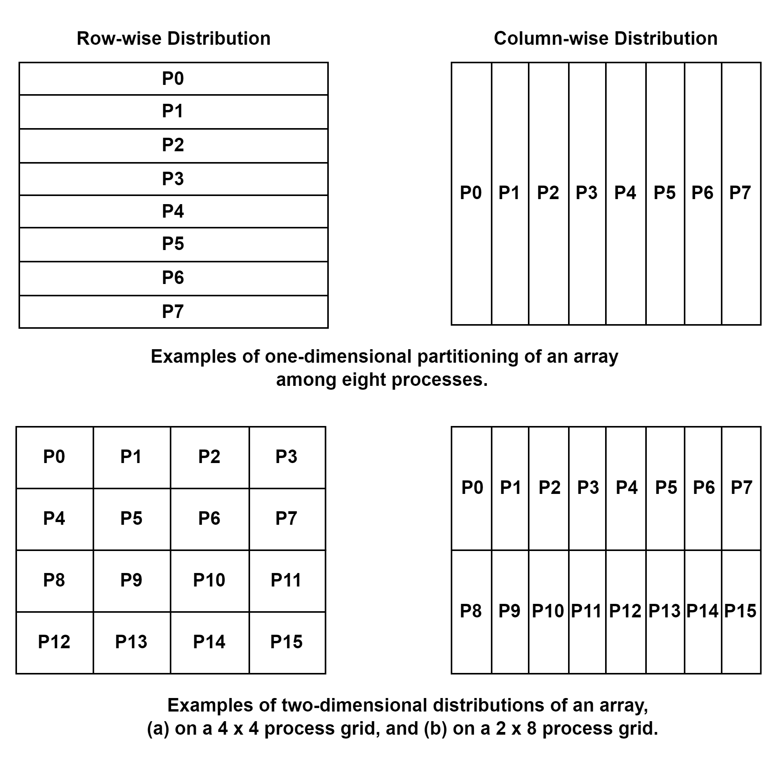
Mappings Based on Data Partitioning: Block Array Distribution
The data partitioning can be combined with the “owner-computes” rule to partition the computation into subtasks. The simplest data decomposition schemes for dense matrices are 1-D block distribution schemes.
In general, higher dimension decomposition allows the use of higher number of processes.

Slide 24
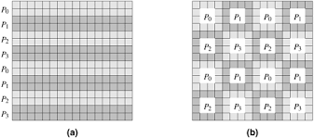
Mappings Based on Data Partitioning: Cyclic and Block-Cyclic Distributions
The central idea behind a block-cyclic distribution is to partition an array into many more blocks than the number of available processes.
Then we assign the partitions (and the associated tasks) to processes in a round-robin manner so that each process gets several non-adjacent blocks.
More precisely, in a one-dimensional block-cyclic distribution of a matrix among p processes, the rows (columns) of an n x n matrix are divided into ap groups of n/(ap).
Examples of one- and two-dimensional block-cyclic distributions among four processes. (a) The rows of the array are grouped into blocks each consisting of two rows, resulting in eight blocks of rows. These blocks are distributed to four processes in a wraparound fashion. (b) The matrix is blocked into 16 blocks each of size 4 x 4, and it is mapped onto a 2 x 2 grid of processes in a wraparound fashion.

Slide 25
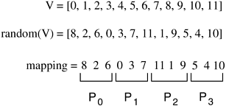
Mappings Based on Data Partitioning: Randomized Block Distribution
Just like a block-cyclic distribution, load balance is sought by partitioning the array into many more blocks than the number of available processes.
However, the blocks are uniformly and randomly distributed among the processes.
A one-dimensional randomized block mapping of 12 blocks onto four process (i.e., a = 3) is shown figure.

Slide 26
CS621 Parallel and Distributed Computing
Schemes for Static Mapping Cont…

Slide 27
Mappings Based on Task Partitioning
Partitioning a given task-dependency graph across processes.
Determining an optimal mapping for a general task-dependency graph is an NP-complete problem.
Excellent heuristics exist for structured graphs.

Slide 28
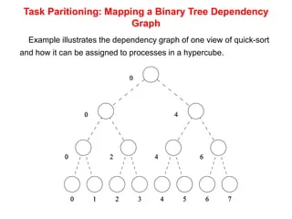
Mappings Based on Task Partitioning: Mapping a Binary Tree Dependency Graph
Example illustrates the dependency graph of one view of quick-sort and how it can be assigned to processes in a hypercube.

Slide 29
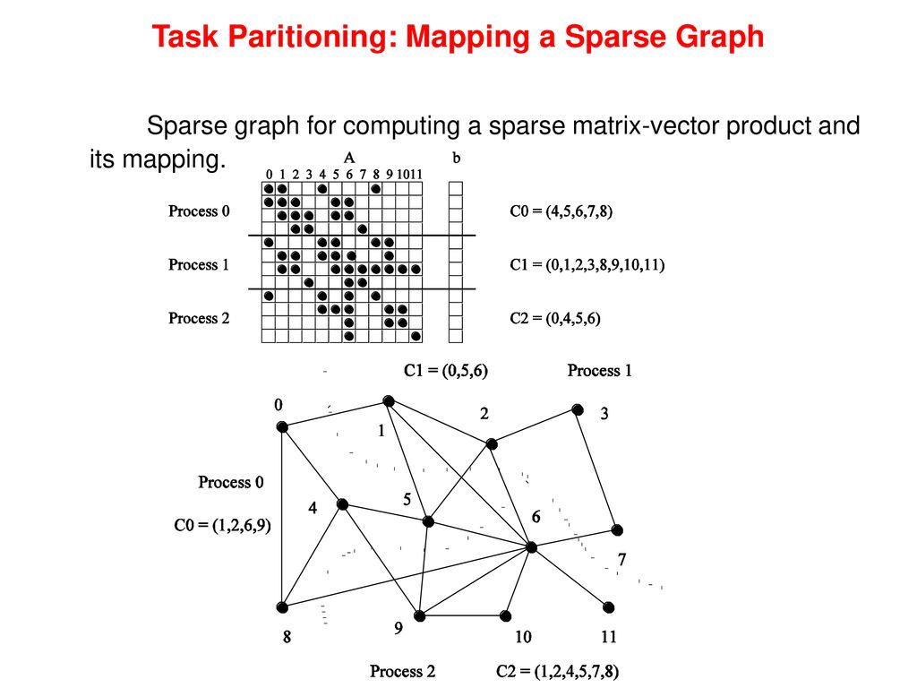
Mappings Based on Task Partitioning: Mapping a Sparse Graph
Reducing interaction overhead in sparse matrix-vector multiplication by partitioning the task-interaction graph.

Slide 30
Hierarchical Mappings
“A hierarchical mapping can have many layers and different decomposition and mapping techniques may be suitable for different layers.”

Slide 31
Hierarchical Mappings Cont…
If the tasks are large enough, then a better mapping can be obtained by a further decomposition of the tasks into smaller subtasks.
A single mapping is inadequate.
Task mapping at the top layer and Data partitioning within each level.
Static mapping based on hierarchical mappings can be used in a variety of applications, including scientific simulations, machine learning, and image processing.

Slide 32
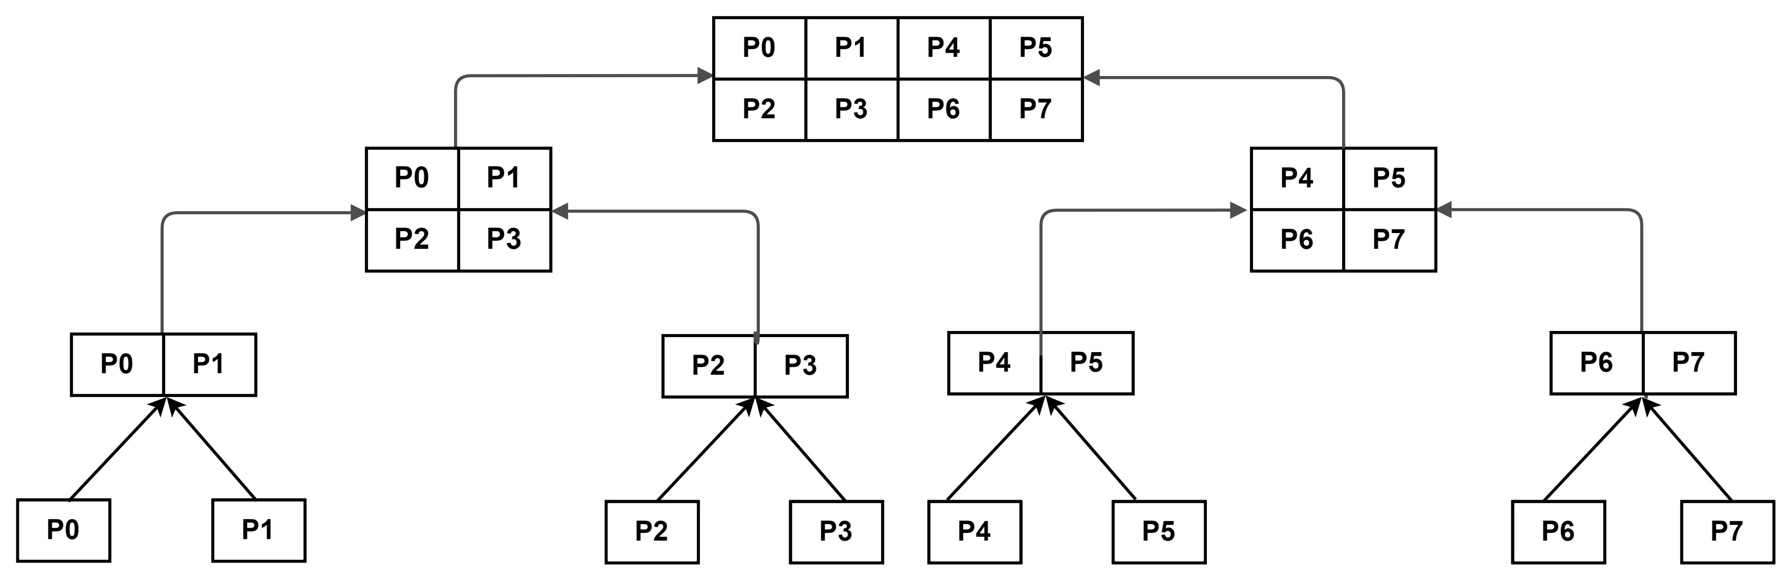
Hierarchical Mappings Cont…
An example of hierarchical mapping of a task-dependency graph. Each node represented by an array is a supertask. The partitioning of the arrays represents subtasks, which are mapped onto eight processes.

Slide 33
CS621 Parallel and Distributed Computing
Dynamic Mapping for Load Balancing

Slide 34
Objectives
Introduction of Dynamic Mapping.
Advantages of Dynamic Mapping.
Disadvantages of Dynamic Mapping.

Slide 35
Dynamic Mapping for Load Balancing
“Dynamic mapping techniques distribute the work among processes
during the execution of the algorithm.”

Slide 36
Dynamic Mapping for Load Balancing Cont…
If tasks are generated dynamically, then they must be mapped dynamically too.
If task sizes are unknown, then a static mapping can potentially lead to serious load-imbalances and dynamic mappings are usually more effective.
If the amount of data associated with tasks is large.

Slide 37
Advantages of Dynamic Mapping
Greater Resource utilization.
The process allocation can be modified during execution if required.
Enhanced Load Balancing
Scalability: Dynamic mapping can scale the system up or down based on the workload.

Slide 38
Disadvantages of Dynamic Mapping
Algorithms that require dynamic mapping are usually more complicated, particularly in the message-passing programming paradigm.
Greater overhead due to process redistribution.
Lack of determinism: Dynamic mapping introduces non-determinism into the system

Slide 39
CS621 Parallel and Distributed Computing
Schemes for Dynamic Mapping

Slide 40
Objectives
Schemes for Dynamic Mapping.
Centralized Dynamic Mapping Scheme.
Distributed Dynamic Mapping Scheme.

Slide 41
Schemes for Dynamic Mapping
Schemes for Dynamic Mapping:
Centralized Schemes
Master Process
Slave Processes
Distributed Schemes

Slide 42
Centralized Dynamic Load Balancing Scheme
All executable tasks are maintained in a common central data structure, or they are maintained by a special process. If a special process is designated to manage the pool of available tasks, then it is often referred to as the master and the other processes that depend on the master to obtain work are referred to as slaves.
Whenever a process has no work, it takes a portion of available work from the central data structure or the master process.
When a new task is generated, it is added to this centralized data structure or reported to the master process.

Slide 43
Centralized Dynamic Load Balancing Scheme Cont…
Centralized load balancing schemes are usually easier to implement than distributed schemes.
If number of processes increases, master may become the bottleneck.
Chunk scheduling: A process picks up multiple tasks at once.
Large chunk sizes may lead to significant load imbalances as well.
Schemes to gradually decrease chunk size as the computation progresses.

Slide 44
Distributed Dynamic Load Balancing Scheme
“In a distributed dynamic load balancing scheme, the set of executable tasks are distributed
among processes which exchange tasks at run time to balance work. Each process can send
work to or receive work from any other process.”

Slide 45
Distributed Dynamic Load Balancing Scheme Cont…
Alleviates the bottleneck in centralized schemes. Critical parameters of a distributed load balancing scheme are as follows:
How are the sending and receiving processes paired together?
Is the work transfer initiated by the sender or the receiver?
How much work is transferred in each exchange?
When is the work transfer performed?

